Slide 1

Data Science Green Belt
Week 1
Evolution 1
12/6/2022

Slide 2
Agenda
What is Data Science?
How Does Data Science differ from....?
Career Prospects
Git Hub
Project Review
Folder Structure
Homework Assignment

Slide 3

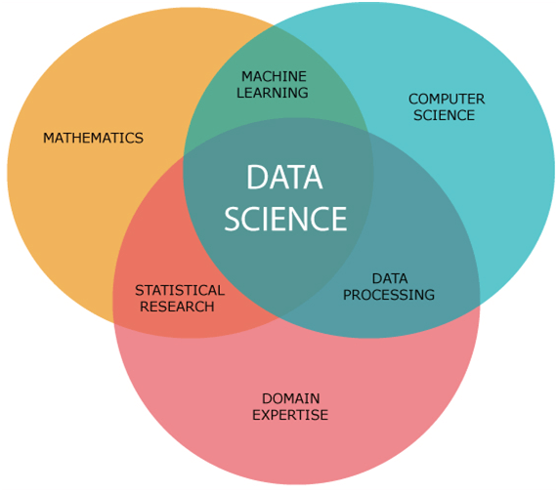
What is Data Science?
Data science is the study of data to extract meaningful insights for business. It is a multidisciplinary approach that combines principles and practices from the fields of mathematics, statistics, artificial intelligence, and computer engineering to analyze large amounts of data. This analysis helps data scientists to ask and answer questions like what happened, why it happened, what will happen, and what can be done with the results.

Slide 4
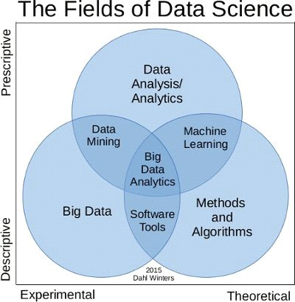
What is Data Science?

Slide 5
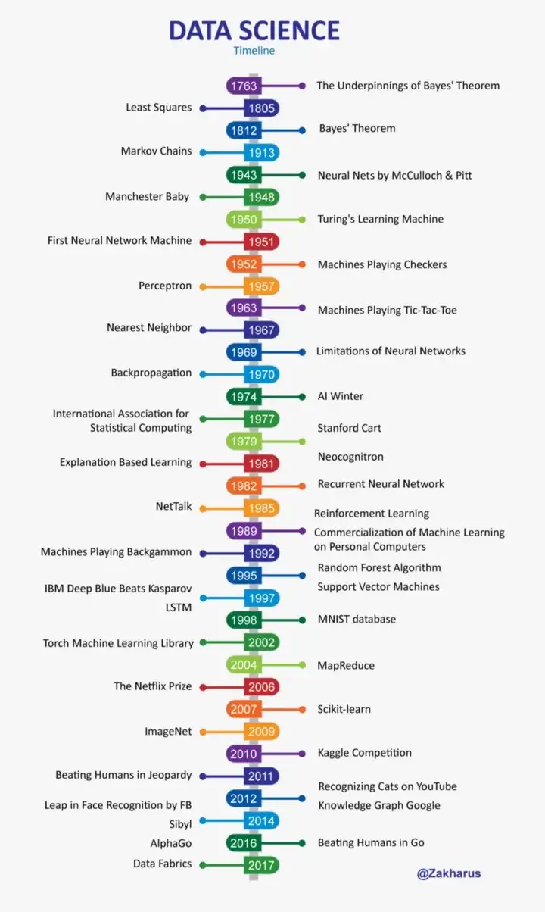
What is Data Science?

